Slide 1
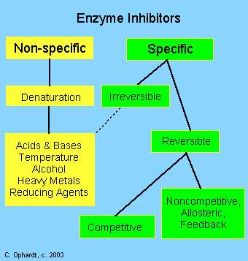
Enzyme inhibitors
Enzyme inhibitors: Enzyme inhibitors are substances which alter the catalytic action of the enzyme by prevent the formation of an enzyme-substrate complex and consequently slow down, or in some cases, stop catalysis. There are a variety of types of inhibitors including: nonspecific, irreversible, reversible - competitive and noncompetitive. Poisons and drugs are examples of enzyme inhibitors.

Slide 2
Enzyme inhibitors
Specific Inhibitors:
Specific Inhibitors exert their effects upon a single enzyme. Most poisons work by specific inhibition of enzymes. Many drugs also work by inhibiting enzymes in bacteria, viruses, or cancerous cells .
Competitive Inhibitors:
Competitive Enzyme Inhibitors work by preventing the formation of Enzyme-Substrate Complexes because they have a similar shape to the substrate molecule. This means that they fit into the Active Site, but remain unreacted since they have a different structure to the substrate. Therefore less substrate molecules can bind to the enzymes so the reaction rate is decreased.
Competitive Inhibition is usually temporary, and the Inhibitor eventually leaves the enzyme. This means that the level of inhibition depends on the relative concentrations of substrate and Inhibitor, they are competing for places in enzyme Active sites .
for example A drug, disulfiram (Antabuse the commercial name) inhibits the aldehyde dehydrogenase (enzyme responsible of alcohol metabolism) which causes the accumulation of acetaldehyde with subsequent unpleasant side-effects of nausea and vomiting if alcohol tacked after this drug. This drug is sometimes used to help people overcome the drinking habit.
Methanol poisoning occurs because methanol is oxidized by Alcohol dehydrogenases (ADH) enzyme to formaldehyde and formic acid which attack the optic nerve causing blindness. Ethanol is given as an antidote for methanol poisoning because ethanol competitively inhibits the oxidation of methanol. Ethanol is oxidized in preference to methanol and consequently, the oxidation of methanol is slowed down so that the toxic by-products do not have a chance to accumulate.

Slide 3
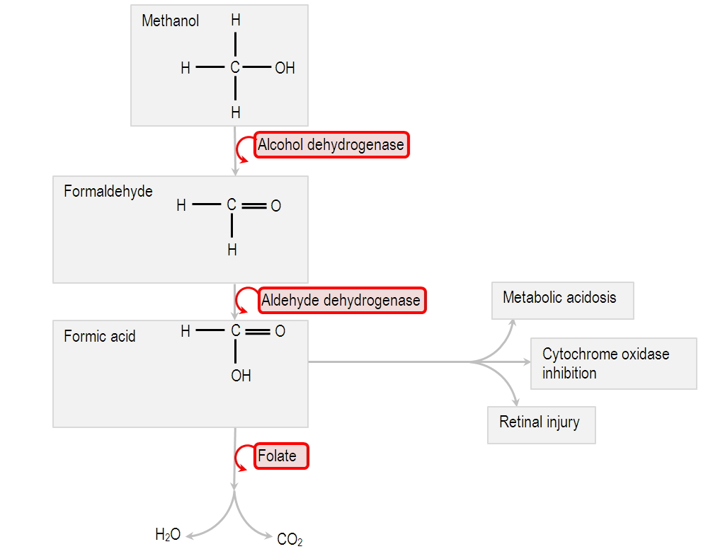
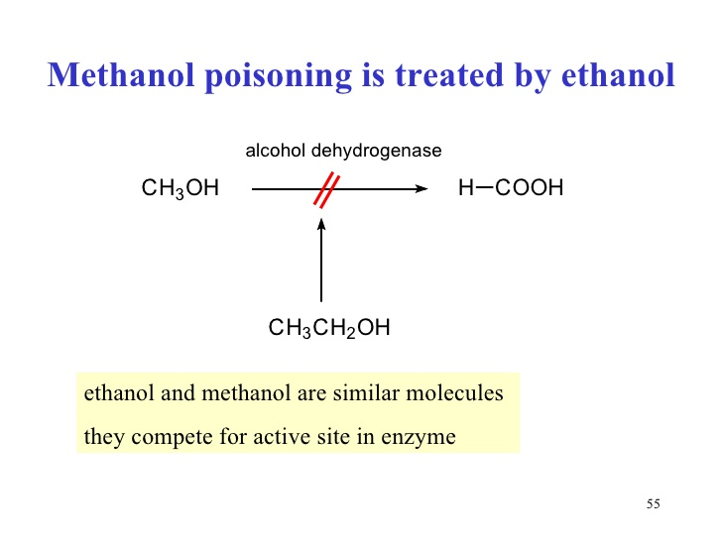

Slide 4
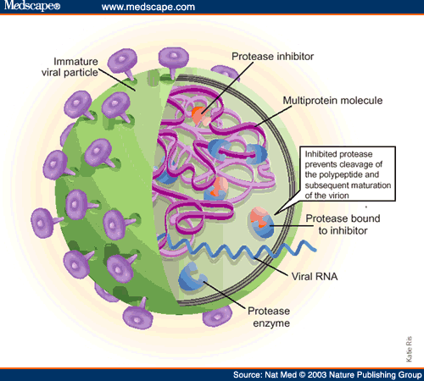
Some Enzyme Inhibitors can be used as Medicines in the treatment of conditions. For example, infection by viruses can be treated by Inhibitors to the viral enzyme Protease, often competitive Inhibitors. This means that viruses cannot build new protein coats and therefore cannot replicate.

Slide 5
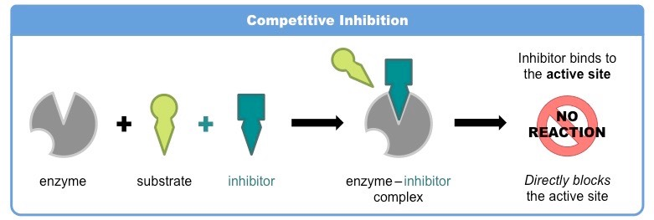
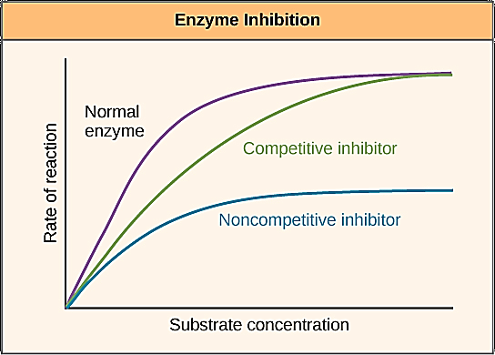

Slide 6
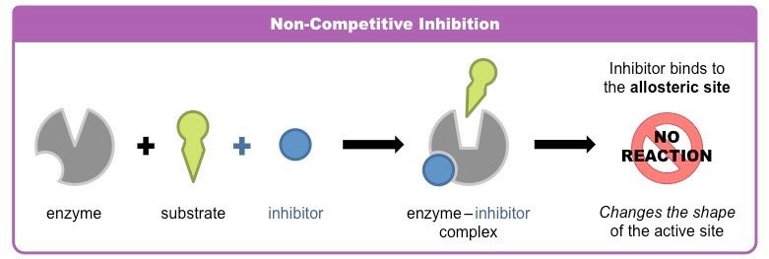
Enzyme inhibitors
Non competitive Inhibitors:
A noncompetitive inhibitor is a substance that interacts with the enzyme, but usually not at the active site. The noncompetitive inhibitor reacts either isolated from or very close to the active site. The net effect of a non competitive inhibitor is to change the tertiary structure of the enzyme and thus the active site, so that the substrate can no longer interact with the enzyme to give a reaction. Non competitive inhibitors are usually reversible. For example in the enzyme-catalyzed reactions, phosphoenol is catalyzed by pyruvate kinase into pyruvate. Alanine is an amino acid that inhibits the enzyme pyruvate kinase during glycolysis. In glycolysis, the end product is pyruvate. However alanine is a non-competitive inhibitor, therefore it doesn't need an active site to bind to the substrate to still become the final product.

Slide 8
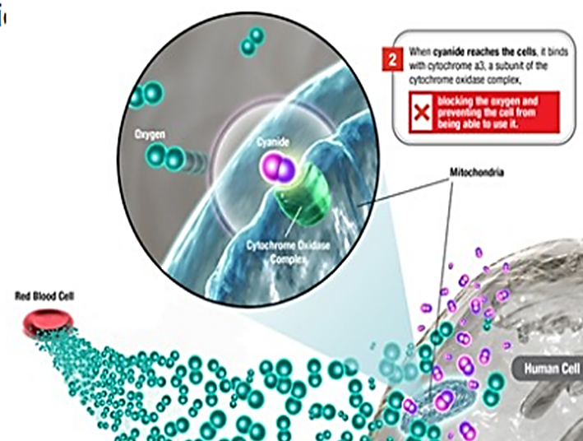
Enzyme inhibitors
Irreversible Inhibitors form strong covalent bonds with an enzyme. These inhibitors may act at, near, or distant from the active site. Consequently, they may not be displaced by the addition of excess substrate. In any case, the basic structure of the enzyme is modified to the degree that it stops to work.
Since many enzymes contain sulfhydral (-SH), alcohol, or acid groups as part of their active sites, any chemical which can react with them acts as an irreversible inhibitor. Heavy metals such as Ag⁺, Hg²⁺, Pb²⁺ have strong affinities for -SH groups.
For example, Potassium Cyanide is an irreversible Inhibitor of the enzyme Cytochrome C Oxidase, which takes part in respiration reactions in cells. If this enzyme is inhibited, ATP cannot be made since Oxygen use is decreased. This means that cells can only respire Anaerobically, leading to a build up of Lactic Acid in the blood. This is potentially fatal.

